Slide 1

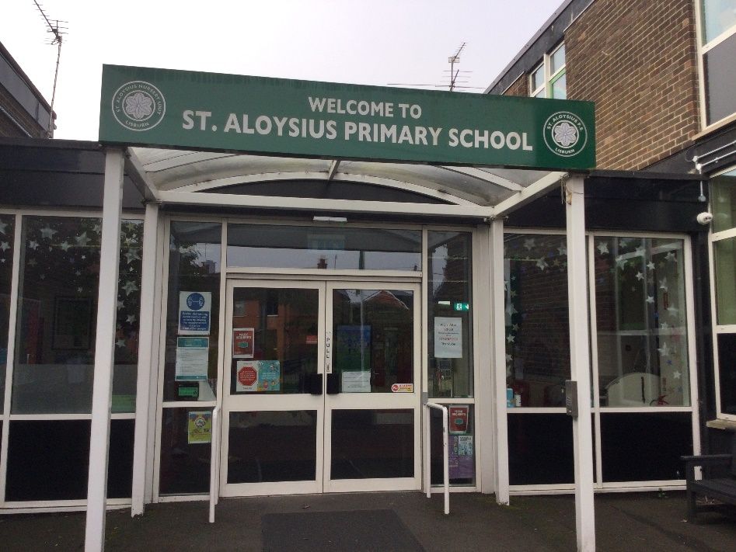
Primary 4 Curriculum Overview 2026-27
“To live, love and learn in a caring Catholic community.”

Slide 2
P4 Curriculum
Numeracy
Literacy
World Around Us
Physical Education
The Arts
PDMU
Grow In Love
ICT

Slide 3




Numeracy Overview
Mental Maths:
Counting on and back
Rounding up and down
Ordering numbers
Freckle / Topmarks
Number:
Place value to 999
Addition and subtraction within 999
Multiplication and division (2/3/5/10)
Measure:
Length – using a ruler – cm / m
Weight – g / kg
Capacity ml / l
Time – counting 5 minute intervals
Shape and Space:
2D & 3D Shapes
Area & perimeter
Symmetry
Problem Solving:
Word problems
Mathematical language
Different strategies
Apply knowledge and understanding
Data Handling:
Collect, interpret and present data
Pictograms, Bar graphs, Venn & Carroll Diagrams

Slide 4




Reading
Talking & Listening
Writing

Slide 5

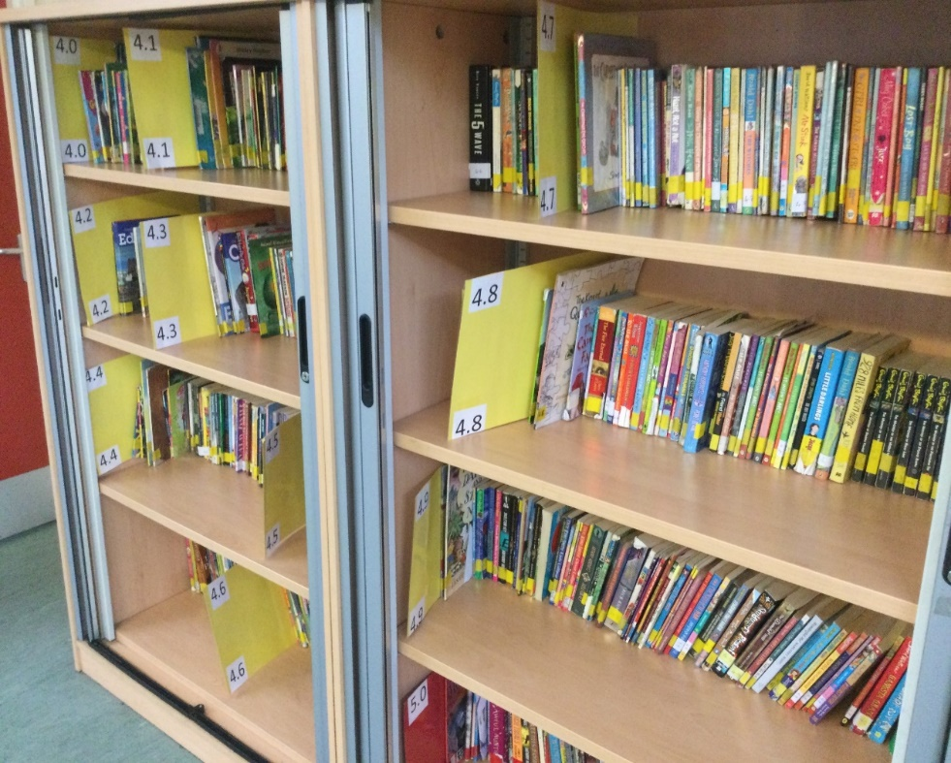
Each week the children will borrow AR books from school library
Levels tailored to reading ability – Star Reading Test
Children take 2 books home each week to read. Return to class on Friday
AR tests to be completed in school
https://ukhosted49.renlearn.co.uk/2235199/

Slide 6
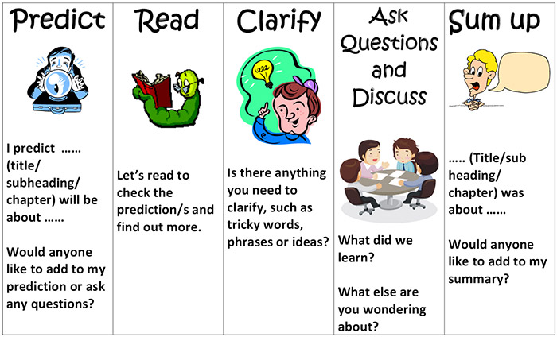
Comprehension

Slide 7

Reading tips to help your child
Find a quiet place
Use phonic strategies to identify unfamiliar words
Look at punctuation marks to develop fluency and expression
Talk to your child about the story
Discuss the illustrations
Retell the story
Recall previous chapters
Describe the story setting, events and characters
Ask who was your favourite character? Why?
Which part did you like best?
Can you predict what will happen next?
Look up unfamiliar words using a dictionary/online dictionary
Linguistic Phonics Programme

Slide 8

Writing
Presentation
Accurate letter formation
Begin sentences at the margin
Write on the line
Spacing between words
Understand the range of writing forms with guidance.
Recount
Procedural
Narrative
Report
Explanation
Persuasion
Spelling, Grammar and Punctuation
Learn spellings and apply phonic strategies to unfamiliar words.
Parts of Speech
Use accurate punctuation
Express a range of thoughts and feelings and begin to write with greater independence and imagination.

Slide 9




World Around Us

Slide 10

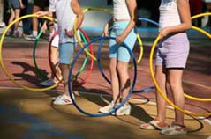
The Arts
P.E, Music & Drama

Slide 11



Grow In Love & PDMU

Slide 12




ICT
Desktop publishing
Research
Digital Storytelling
Green Screen
Word Processing & PowerPoint

Slide 13

Seesaw codes will be sent home this week. This app enables us to establish an effective form of communication between home and school.
Please check this app regularly as messages and updates will be sent regarding your child’s class.
Teachers will respond to Seesaw messages before school starts: 8.30am – 8.45pm & from 3.00pm – 4.00pm.
Please contact the school office (028 9266 2293) with any urgent messages, during the school day.
Seesaw is closed for all communication at the weekend and each evening.
We would actively encourage you to keep us updated on any developments that could affect your child’s education.

Slide 14
Homework
Homework is used to reinforce what we are learning in class. It should take no longer than 30 minutes for a written homework. Please check your child’s homework and sign.
Monday: Literacy- Comprehension
Tuesday: Mental Arithmetic ( 1 page)
Wednesday: Grammar (1-2 pages)
Thursday: Freckle – 2 tasks
*Learn spellings and read for 20 minutes every night. Spellings / mental maths test will take place every Friday. Test books will be sent home on Monday to be signed and return on Tuesday.
*Accelerated Reading quizzes can be completed in school each morning.
Homework must be returned each morning to be marked as a whole class (Mental Arithmetic)
Homework will begin w/c 7th September 2026

Slide 15
First Holy Communion
Date: Saturday 15th May 2027 – Further details to follow
If your child will not be making their First Holy Communion please let us know closer to the time.
In preparation for First Holy Communion:
Baptismal Certificate
First Confession
Assembly after Christmas
Church visits / participate in online mass

Slide 16

Other Information:
Parent Teacher Meetings will be held on
Monday 30th November 2026.
Dinners – Please remember to book dinners. Our procedure is for the office to phone and request a lunch. FSM need to be renewed again.
We look forward to working in partnership with you this year.
Miss Calpin/Mrs Rooney P4A
Mrs Hanna/Miss Greene P4B

