Slide 1
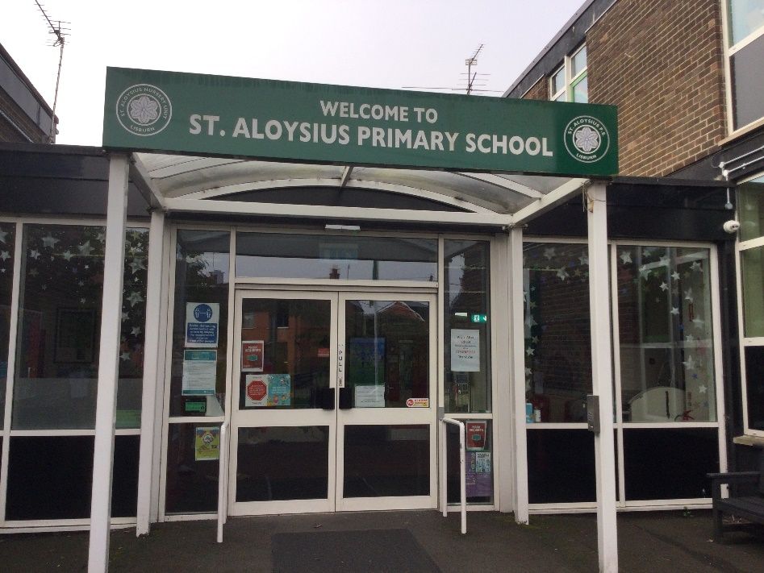
Primary 2 Curriculum
Overview 2026-2027
“To live, love and learn in a caring Catholic community.”
P2A Miss Donnelly
P2B Mrs Russell

Slide 2

P2 Curriculum
Literacy/ Communication
Talking and Listening
Reading
Writing
Maths/ Numeracy
Number
Data Handling
Shape and Space
Measure
Learning Through Play
World Around Us (History/Geography/Science/Technology)
Personal Development and Mutual Understanding (PDMU)
The Arts (Art/Drama/Music)
Religion- Grow in Love
Physical Education (PE)

Slide 3
Literacy
Talking and Listening
Listening to each other
Listening to instructions
Discussing what they have read / learned / opinions
Concentration
Listening for sounds.
Reading
Guided reading as part of a group
Shared reading (Big Book)
Linguistic Phonics
Identifying key words.
Writing
Letter formation (*reversals)
Writing opportunities
Independent writing (Term 2 and 3).

Slide 4
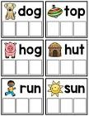
Linguistic Phonics
In P2 we revise all initial letter sounds.
Once the children know a sound they can read and write simple words.
Activities- Whiteboards/magnetic letters
Paper squares for word-building
Target Words- spellings will be introduced in Term 2.
Check out the Jolly Phonics song on Youtube to help your child revise each sound.
https://www.youtube.com/watch?v=jvAYUvQUrGo

Slide 5
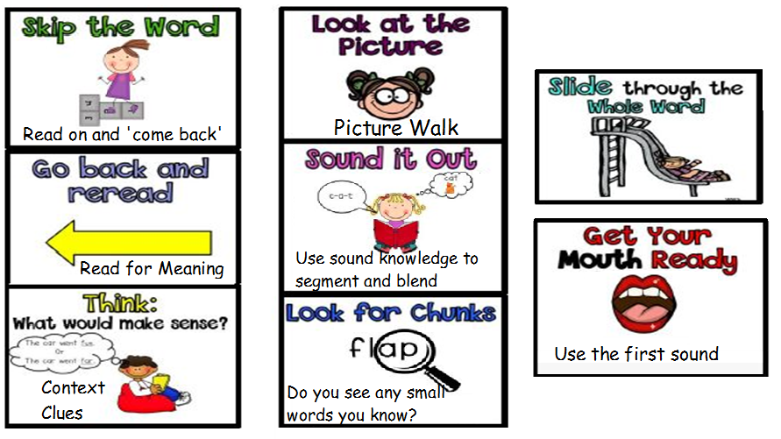
Reading Strategies

Slide 6

Numeracy
Mental Maths
Counting 1 more/ 1 less
Numbers before, after, between
Adding 0,1 or 2 to a number.
Number:
Read, Write, Count and order to 50
Addition and subtraction within 20.
Number stories to 15.
Odd and even numbers
Problem Solving:
Mathematical language
Investigations
Applying different strategies.
Shape and Space:
2D & 3D Shapes
Positional Language
Measure:
Length
Weight
Capacity
Time- Digital/ analogue, (o’clock/half past)
Data Handling:
Collect, interpret and present data
Pictograms, Bar graphs, Venn & Carroll Diagrams.s.

Slide 7
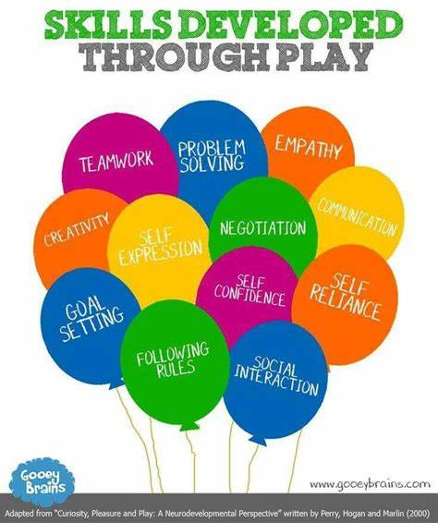
Learning Through Play
Children will engage in a number of play sessions through the week. The areas of play are as follows:
Role Play
Sand
Water
Dough/Clay
Tabletop
Small world
Construction
Creative

Slide 8

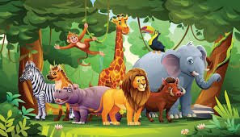

World Around Us
History, Geography, Science and Technology
Term 1
People Who Help Us
Dinosaurs
Christmas
Term 2
Pirates
Superheroes
Term 3
The Jungle
Summer

Slide 9


Grow in Love & PDMU
Our World
We Belong
We Remember
Advent and Christmas
Jesus and the Holy Family
PDMU
Pupils will develop an understanding of themselves and their personal attributes through exploration of who they are and what they can do through the incredible years programme.
High 5 Friday
They will develop an understanding of their feelings by exploring how to express their emotions and how these emotions can affect others.

Slide 10

Physical Education
Games
Gymnastics
Dance
Athletics
Outside coaching

Slide 11
Homework
Reading homework- The books are kept for the week.
(Please see Reading strategies slide above to help you help your child with their reading skills.)
Key word list to be learned every night. These will be tested on a Friday morning.
Monday – Literacy, reading, keywords
Tuesday – Numeracy, reading, keywords
Wednesday – Grow in Love (RE), reading, keywords
Thursday – Phonics, reading, keywords
Encourage correct number and letter formation when completing homework (See next slide).
All homework should be returned on Friday morning.

Slide 12
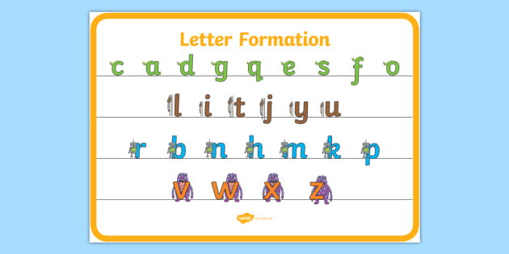
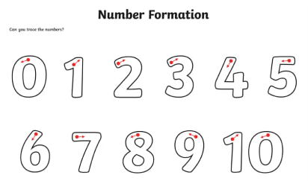
Letter and Number Formation

Slide 13

Seesaw
This app enables us to establish an effective form of communication between home and school.
We would actively encourage you to keep us updated on any developments that could affect your child’s education.
We cannot read or respond to seesaw messages during teaching time. Please call the office if something is urgent. Please also be mindful when using seesaw that messages are respectful and necessary.
Seesaw is accessed by staff Monday- Friday during school hours only (8:30-9:00am and 2pm-4pm). Staff will only respond to messages during the above times.

Slide 14
Additional Information
Class starts promptly @ 9.00am.
If your child comes in after 9.00am marked L on the attendance register.
After 9.10am they will be marked U.
(the ‘minutes late’ automatically total and reduces the percentage attendance).
Dinner- remember to book dinners on Eduspot by 12 midnight the previous evening.
Home time: Monday-Thursday 1.55pm from the back yard. Friday 1:50pm.
PE Day –Tuesday.
We would recommend a healthy snack for break time (2 small items) with water or milk to drink.
Parent Teacher Meetings- Monday 30th November 2026.
Digital media consent forms will be sent in due course. No photographs will appear without consent.
.

Slide 15

Our doors are always open.
A partnership between home and school benefits your child. If you have any issues appointments can be made through the school office or message via Seesaw.
Miss Donnelly & Mrs Russell

