Slide 1

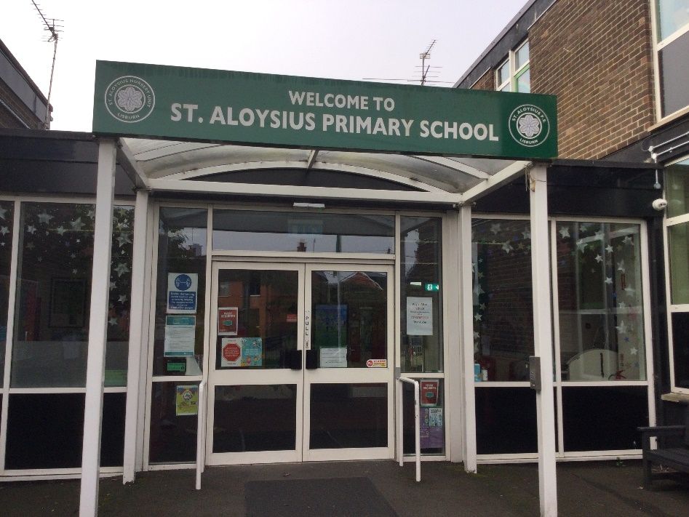
Primary 1 Curriculum Overview 2025-26
“To live, love and learn in a caring Catholic community.”

Slide 2
P1 Curriculum
Numeracy
Literacy
World Around Us
Physical Education
The Arts
PDMU
Grow In Love
ICT

Slide 3




Numeracy Overview
Collins Busy Ant Maths scheme
Number:
Use, count and add numbers up to 15
Understand conservation of number
Create and describe repeating patterns
Use and count 1p coins
Identify 1p, 2p, 5p, 10p & 20p coins
Measure:
Length
Weight
Capacity
Time: O’clock/ days of the week/ sequence familiar events
Mental Maths:
Counting on and back
Ordering numbers
Numbers before/ after/ less/ more
Problem Solving:
Use relevant Mathematical language
Talk about ways to solve simple everyday problems
Look for and talk about patterns and shapes
Shape and Space:
Sort and name 2D and 3D shapes
Use language and follow instructions during practical activities for position and movement
Data Handling:
Sort and classify real objects for one criterion
Resort for a second criterion
Collect information and record using real objects

Slide 4




Reading
Talking & Listening
Writing

Slide 5


Reading tips to help your child
Please read with your child at home every day.
Find a quiet place.
Use letter sounds/ Jolly Phonics to read unfamiliar words.
Look at punctuation marks to develop fluency and expression.
Talk about the pictures.
Retell the story/familiar bedtime stories.
Talk about the story setting, events and characters.
Ask who was your favourite character? Why?
Which part did you like best?
Can you predict what will happen next?

Slide 6


Reading
Phonics/ Talking and Listening
We use the Jolly Phonics Programme.
The P1 Staff are trained in ELKLAN, Small Talk NI and Early Talk Boost.
Where do we begin in P1?
Guided reading – all children need to:
Hold copies of their own text.
Turn the pages by themselves.
Move at their own pace with the guidance of the teacher.
Oxford Reading Tree scheme.
The ‘Easy Read Books’ will be sent home each MONDAY.
Please return the books to school each THURSDAY.
The children will receive a book home when they are reading confidently in TERM 2. These ‘Easy Read Books’ are for your child to read and enjoy with you.

Slide 7
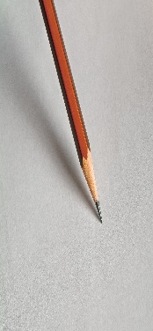
Writing
Pencil Grip
We are using the pincer grip to hold a pencil.
P1 teachers follow the Early Writing Skills Programme and the Cambridge PENPALS for Handwriting.
Letter formation
We write using the pre-cursive letter formation.
Practise using a wide variety of media: chalk, markers, pencils and crayons.
Independent Writing
We are working towards producing our own piece of writing, in a clear and organised way.
.
Shared Writing
Procedural writing
Recount writing
Lists
Invitations
Cards
Report writing
Narrative writing

Slide 8


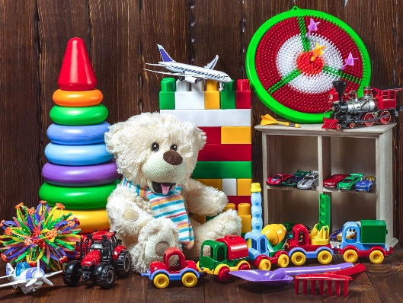
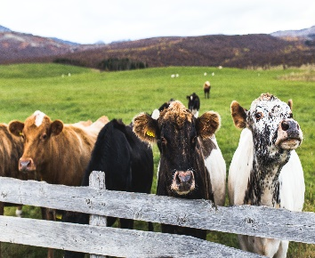


World Around Us
Farm
Toys
Holidays
Spring

Slide 9

Playful Learning
The children will engage in a number of play sessions through the week. The areas of play are as follows:
Role Play
Sand
Water
Dough/ practical cooking
Table top
Small world
Construction/ technology
Creative
Outdoor
ICT
Loose parts play

Slide 10


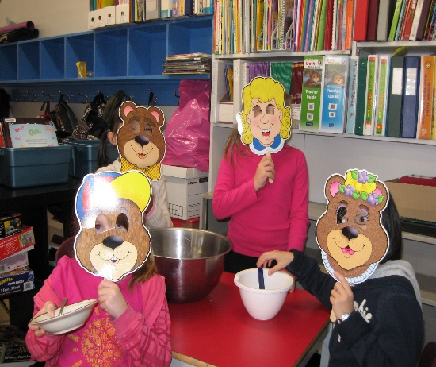
The Arts:
P.E.
Music
Drama

Slide 11


Fostering links between school, home and parish.
The children will come to a deeper understanding of God’s love in their lives.
The children will show love and respect for themselves, each other, God and all creation.
The PDMU content of the curriculum is taught through The Incredible Years Programme.

Slide 12



ICT
Music & Sound
Working Images
Interactive Design
Managing Data
Desk Top Publishing

Slide 13

Thank you for signing up to Seesaw. This app enables us to establish an effective form of communication between home and school.
We would actively encourage you to keep us updated on any developments that could affect your child’s education.
Teachers are able to respond to Seesaw messages before school starts: 8.30am – 8.45pm & from 3.00pm – 4.00pm.
Please contact the school office (028 9266 2293) with any urgent messages, during the school day.
Seesaw is closed for all communication at the weekend and each evening.

Slide 14
Homework
Monday: Literacy
Tuesday: Numeracy
Wednesday: Grow In Love workbook
Thursday: Phonics/ key word revision
Bedtime story
*Please check and sign the homework.
*The children will receive a book home when they are reading confidently in TERM 2. These ‘Easy Read Books’ are for your child to read and enjoy with you.

Slide 15
General Information
A partnership between home and school is ESSENTIAL for your child to achieve their full potential.
The classroom opens: 8.45am.
Teaching commences: 9.00am.
Outside play: 10.10-10.20am. Morning snack: Please pack milk or water; vegetables; bread-based snack with a sugar free filling.
Dinner time: 11.55am-12.30pm. Please book a dinner on EduSpot before midnight, the previous day.
Home time: 1.50pm Monday - Thursday at the FRONT DOORS and 1.45pm on Friday, from the NURSERY PLAYGROUND. Please be punctual…thank you.
P.E. for TERM 1 (DAY TO BE CONFIRMED): Please wear school P.E. uniform.
If your child is participating in an afterschool's sports activity , please wear the school P.E. uniform on those days.
All parts of the school uniform MUST be clearly labelled with your child’s class and name – please include school bags, water bottles and lunch bags.
Any children on medication or who have health problems please inform the class teacher. Please contact the office (028) 9266 2293 and fill in the relevant medical form.
If your child needs to go to the toilet more often, please let the class teacher know.
Thursday: Phonics/ key word revision.
Bedtime story.
*Please return the home bag/ reading book every THURSDAY MORNING

Slide 16

Appointments to speak with the class teacher can be made at any stage of the school year. Please phone the school office or message the teacher directly via Seesaw.
*School Photographer: Monday 15 & Tuesday 16 September 2025.
*The Flu Vaccination: Thursday 9 October 2025.
*Parent Teacher Meetings will be held on Monday 8 December 2025.
*The P1 Nativity Play will be on Thursday 18 December 2025.
*End of year Farm Trip: Thursday 25 June 2026.
We look forward to working in partnership with you this year.
Mrs Gray & Mrs Campbell P1A
Mr Hughes, Mrs O’Brien & Mrs Reid P1B

