Slide 1

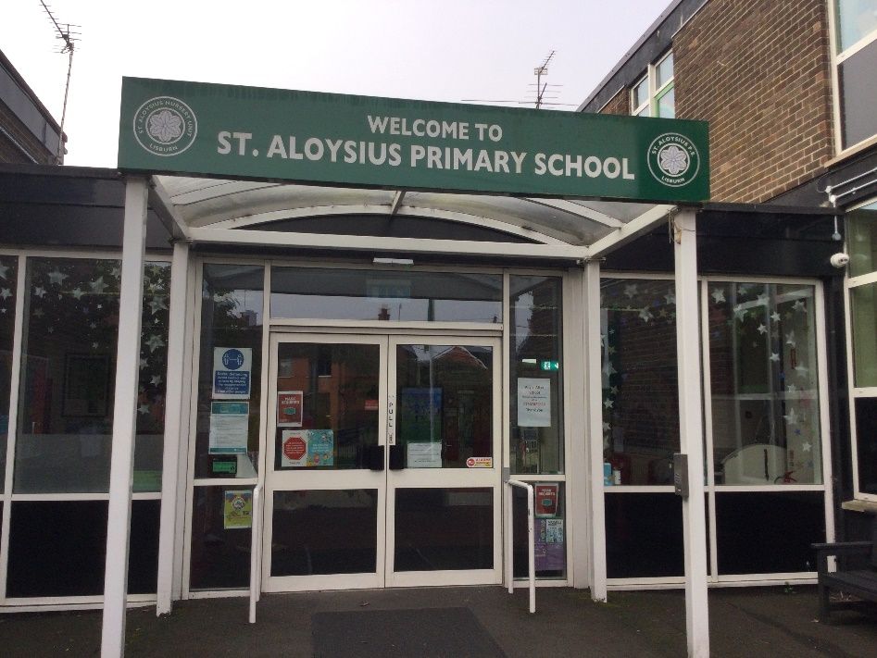
Primary 6 Curriculum Overview 2025-26
Mrs Brennan, Mrs Wright & Mr McCann
“To live, love and learn in a caring Catholic community.”

Slide 2
Core Curricular Areas
P6 Curriculum
Numeracy
Literacy
World Around Us
Physical Education
The Arts
PDMU
Grow In Love
ICT

Slide 3
Literacy Overview
Talking & Listening
Writing
Reading
Class discussions
Comprehension
Cross-curricular learning
Group novel
Class novel
Accelerated reading
Comprehension activities
Creative
VCOP activities
Digital media
Grammar
Parts of speech
Punctuation
Spellings

Slide 4

Reading
  Encourage your child to read at least 20/30 minutes at home every night.
  Discuss with your child what they are reading.
  Read with your child, this will encourage them to enjoy books.
  Visit the local library – it has an extensive collection of AR books
  Play audiobooks – There is a great selection of free ones on the Libby App. (Requires an NI Library card)
  Please encourage your child to engage in AR tasks https://login.renaissance.com/12d2ca95-9a5b-43d7-acc9-1eea477b4030?state=1535d05b-7ed5-409b-8f4c-bfc5e757a9a3

Slide 5


Encourage your child to learn their spellings every night for their Friday test.
Times tables quick recall will boost mental maths skills- continually encourage tables recall through simple quizzes. E.g. Topmarks – Hit the Button.
Ensure that they complete their weekly grammar homework and discuss unfamiliar vocabulary.
Help your child to foster a love of reading by encouraging this at home.
Keep track of your child’s progress on AR.

Slide 6
Numeracy Overview
Numeracy P6
Number
Shape and Space
Measures
Handling Data
Mental Maths
Problem Solving

Slide 7

Maths in Primary 6
Maths in Primary 6 is split into separate Number and Topic lessons each week.
We provide the children with a range of problem-solving investigations to help them develop their mathematical thinking and reasoning skills.
We incorporate daily mental maths activities to help the children focus on quick recall of times tables and number bonds.
We encourage children to show their working out as a way of demonstrating mathematical thinking and understanding
We also remind children that making mistakes is an essential part of the learning process and helps them to develop the skill of self-correcting.

Slide 8


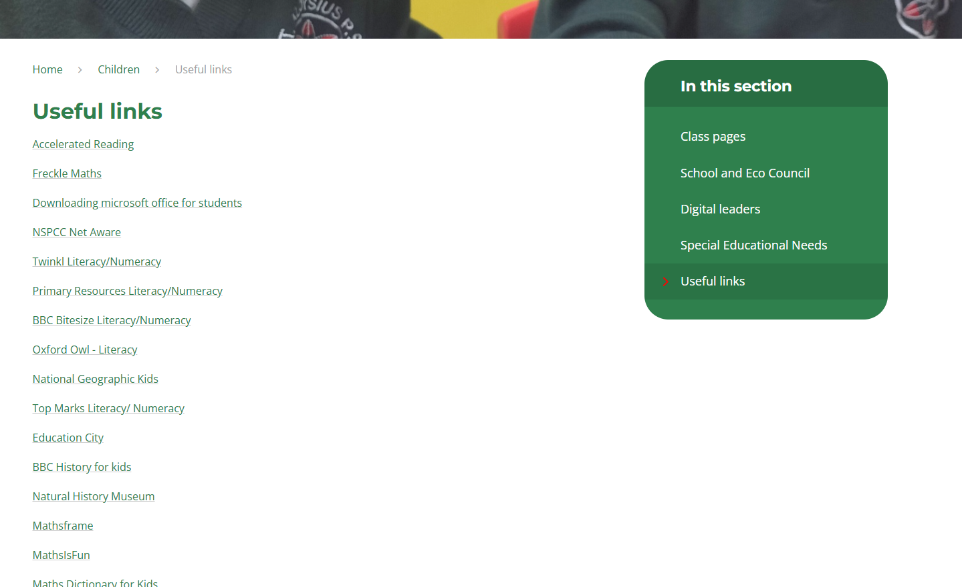

How can you help with maths at home?
Consolidate times tables and basic number facts
Real world experiences e.g. time, money etc.
Encourage independence with homework
Support your child with any challenges that they face
There are a list of helpful websites for Numeracy and Literacy on our school website - https://staloysiusschool.ovw10.juniperwebsites.co.uk/page/?title=Useful+links&pid=102&action=saved

Slide 9

Assessment For Learning (AFL)
Pupil involvement.
Assessment for leaning based upon Learning Intention and Success Criteria.
Peer/Self-Assessment.
Weekly spelling and Mental Maths tests
Target setting.
Half-Termly assessments.
Accelerated Reader/Freckle.

Slide 10
Other Curricular Areas
The World Around Us -
  Natural Disasters
  Christmas Around the World
  Vikings
  Flight
The Arts
  Art Themes: Natural Disasters, Viking, Famous Artists
  Music- Grow in love, Choir, Assemblies, other curricular areas
PDMU- Personal Development And Mutual Understanding
R.E: Grow in Love-O6

Slide 11
Homework Schedule
Monday | Tuesday | Wednesday | Thursday
Guided reading & AR Spellings Times tables Mental Arithmetic Book | Guided reading & AR Spellings Times tables Grammar Book | Guided reading & AR Spellings Times tables Times tables Book | Guided reading & AR Spellings Times tables Other activity (Freckle/Written task)

Slide 12
Transfer 2025-26
Revision club – To start after Easter
March – Parents can register interest in transfer process by contributing to test pack.
Term 3 - Daily transfer papers (½ paper per school night)
Encourage and support.
Keep teacher informed of problem areas.
Commitment
Summer pack available at the end of term 3 (price to be confirmed)
New style S.E.A.G. operated by GL. More information can be found at https://seagni.co.uk/
Registration will take place between May and September. Parents must register their child.
Transfer meeting to take place in term 3.
If you wish to obtain further details on either form of test, please visit the individual Grammar school or The Transfer Test website below
https://www.thetransfertest.com/information-parents

Slide 13

Announcements
Please sign up to the class Seesaw. We will use this as a way of communicating class announcements. It is important that you regularly check your Seesaw app for important updates or notes from the class teacher or Mrs Milne.
We would encourage you to keep us updated on any developments that could affect your child’s education.
Please make contact via Seesaw to tell or explain your child’s absence or let us know if they need to attend an appointment.
We cannot guarantee that it will be checked during teaching time so if you have an urgent message, please contact the school office.
Swimming for P6 will begin on the week beginning 8th September. Money needs to be paid via EduSpot. This will our PE sessions during this term.
Shared Education – 2 classes only.

Slide 14


Healthy Eating
We promote healthy eating throughout the school.
Provide your child with milk or water.
Ensure they are eating plenty of fruit and vegetables.
Let them have some breads –bread sticks, pitta rolls etc.
For fillings promote- tomato, tuna, cheese, chicken , ham or salads.
Avoid sugary spreads, sweetened breads or buns.
Avoid sugary sweets and drinks. Especially energy drinks.
WE THANK YOU FOR YOUR SUPPORT!

Slide 15
Expectations during Primary 6
Promoting independence
Accepting responsibility for their actions
Showing initiative
Building resilience
Showing respect to peers and all staff
Having a positive attitude and ready to embrace new challenges and experiences
Be prepared and organised
Have fun!

Slide 16
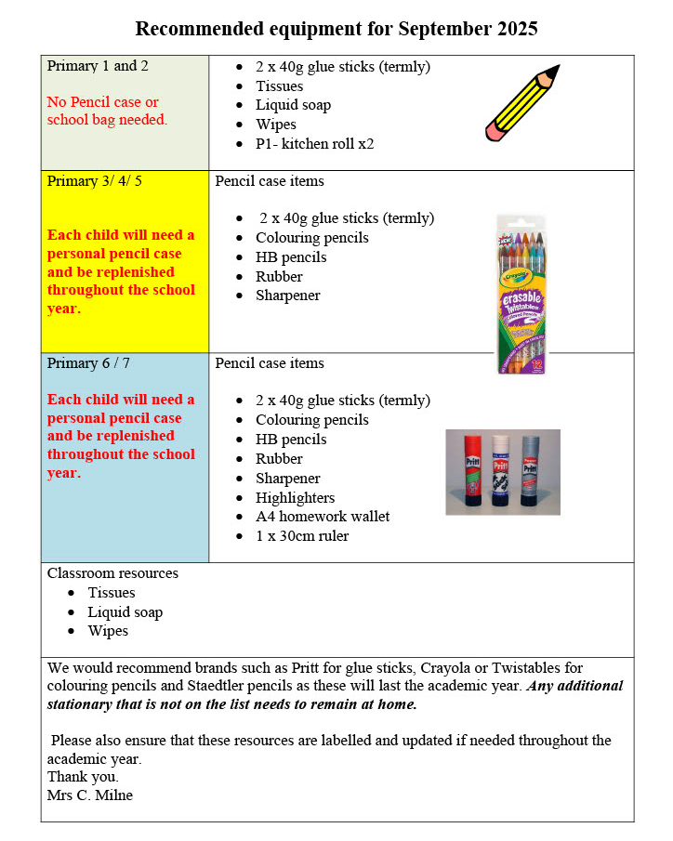
Stationary List

Slide 17

If you have any questions or queries regarding your child, please do not hesitate to contact us.
Mrs Brennan, Mrs Wright & Mr McCann

