Slide 1

Primary 7 Curriculum Overview
Mrs Freeman
&
Mr Hanna
2025-2026

Slide 2

The Revised Curriculum
Communication/Literacy
  Talking & listening
  Reading Group Novel, AR books, Comprehension and Reciprocal reading tasks.
  Writing
Mathematics and Numeracy
  Number
  Data Handling
  Shape & Space
  Measure
The Arts (art, drama and music)
W.A.U. (history, geography, science and technology)
Personal Development & Mutual Understanding (PDMU)
Religion
P.E.

Slide 3

P7 emphasis on…..
Engaging children to plan for their own learning.
Developing independence and creativity skills to help them function effectively in post primary school.
Recognise that school is part of LIFELONG LEARNING.
Active learning - getting involved; recognise different learning styles.
Assessment For Learning:
  Self assessment
  Peer assessment
  Teacher assessment
  Peer mentoring

Slide 4

Maths in Primary 7
Number lessons and Topic lessons e.g. measure, shape and space and data handling taught each week.
Regular problem solving and reasoning opportunities to develop mathematical thinking and processing.
Mental maths revised daily focusing on quick recall of tables and number bonds.
Math’s homework consolidates what is being taught in class.
Working out is an essential process of mathematical thinking and evidence should always be provided.
Making mistakes allows pupils to develop the strategy and skill of self correcting.
Pupils are always encouraged to ask for assistance once they’ve attempted the task themselves.

Slide 5
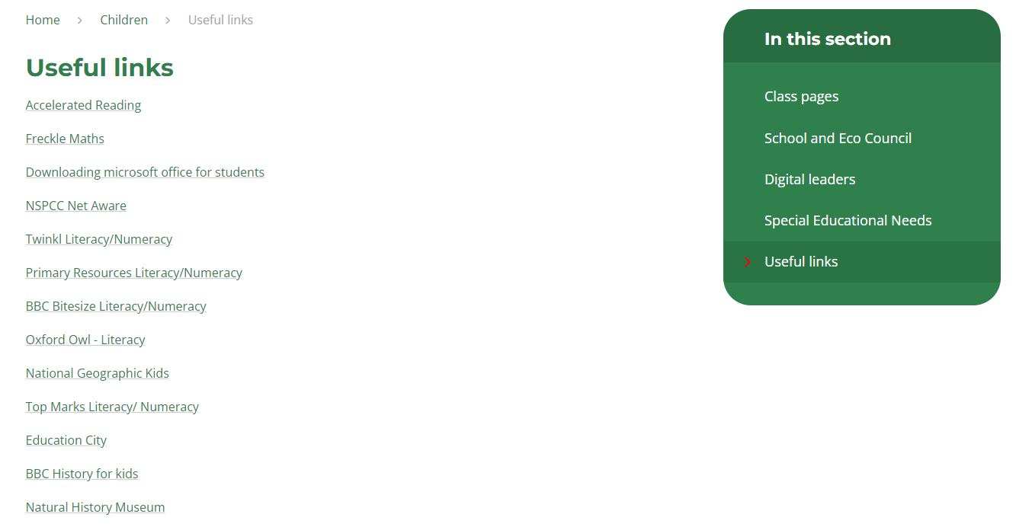
Maths: How you can help at home & useful websites
Consolidate times tables and basic mental maths calculations through family games and challenges.
Use real life experiences as much as possible e.g. time, weighing, measuring, shopping and approximating.
Encourage your child to complete math’s homework independently. You’re welcome to look over, check and correct it with them.
If your child is experiencing any difficulties please encourage them to speak the class teacher.
Useful Mathematics’ websites can be found on the school website on the link below.
https://www.staloysiuslisburn.org.uk/page/?title=Useful+links&pid=102

Slide 6

English in Primary 7- How you can help at home
  Talking & listening
  Talk and listen to your child, you are your child’s role model.
  Listen to their opinions, challenge them and work on extending their language.
  When English is an additional language, it is important your child hears and speaks English as much as possible.
  Reading
  Encourage your child to read at least 20 minutes at home every night.
  Discuss with your child what they are reading.
  Read with your child, this will encourage them to enjoy books.
  Play audiobooks.
  Writing
  Consolidate spellings and meanings with your child, these are important to the writing process.

Slide 7
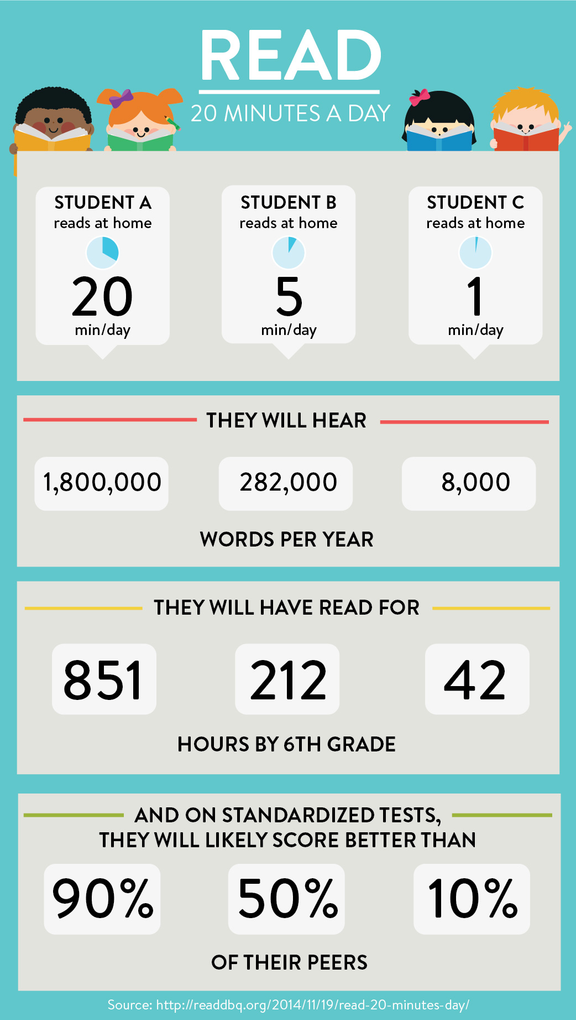
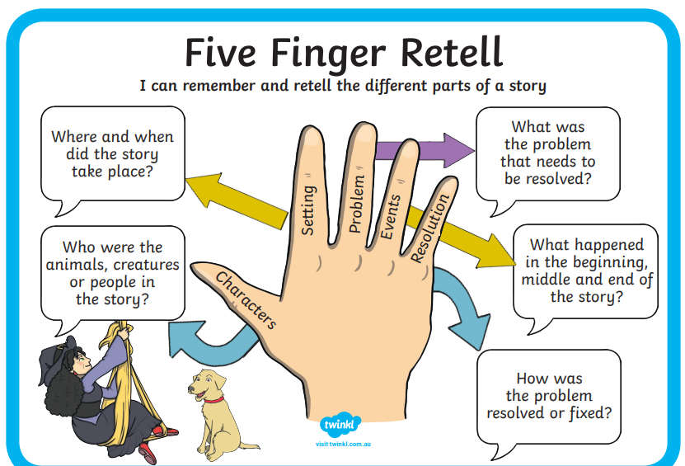
The importance of reading daily
How to help with comprehension

Slide 8
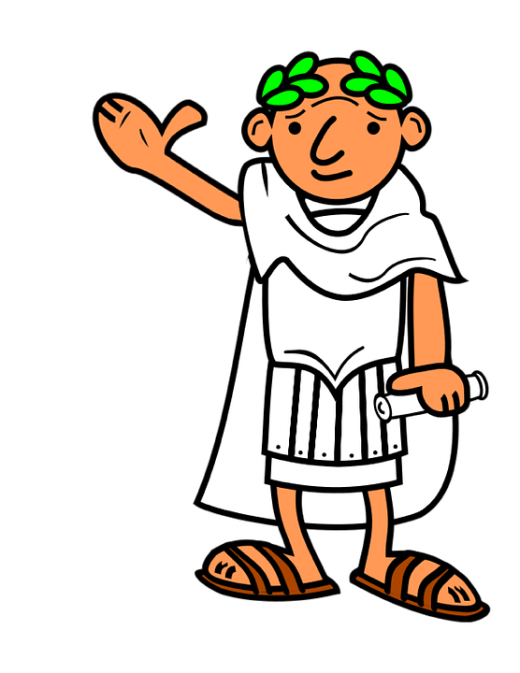
Other Areas of the curriculum
The World Around Us
The Famine and the Victorians
The Arts
Art Themes: Seascapes, Artist studies, WAU art
Music- Choir, Assemblies
Personal Development And Mutual Understanding
Transition to post primary school
Resilience
Mindfulness
Religious Education
Grow In Love P7
Confirmation

Slide 9

Homework
Provide a quiet workspace with the necessary tools to complete homework.
Please check homework is completed and ensure your child has put it in their school bag.
Don’t be tempted to do it!
Don’t get anxious about explaining – teacher's job.
All homework is important e.g. reading, spellings, times tables, researching etc.
Valuable time is given to the marking of homework therefore it is essential that your child brings it to school completed.

Slide 10
Weekly Homework (Post Transfer)
Monday | Tuesday | Wednesday | Thursday
Guided reading & AR Spellings Times tables Mental Arithmetic book | Guided reading & AR Spellings Times tables Grammar book | Guided reading & AR Spellings Times tables Mental Arithmetic book | Guided reading & AR Spellings Times tables Freckle

Slide 11


Opportunities for Development
Sport
After School Activities
Choir
Assemblies/plays
Responsibilities: House Captains, Eco Warriors, School Council
Reading Buddies
Trips- The P7 residential trip is 27th to 29th of May 2026 to Dublin. To include a stadium tour and Emerald Park
Mass & Confirmation

Slide 12


Healthy Eating
We promote healthy eating throughout the school.
Provide your child with milk or water.
Ensure they are eating plenty of fruit and vegetables.
Let them have some breads –bread sticks, pitta rolls etc.
For fillings promote- tomato, tuna, cheese, chicken , ham or salads.
Avoid sugary spreads, sweetened breads or buns.
Avoid sugary sweets and drinks. Especially energy drinks.
WE THANK YOU FOR YOUR SUPPORT!

Slide 13

Transfer Tests
Provide encouragement.
Keep calm.
Promotes high level learning.
Don’t let it be what defines them!
Difficulties/pressures arise speak to teacher.
Non transfer pupils provided work at their own level.
Be mindful of resources used by tutors. Please don’t use any that are being used in school.
Testing will take place 2/week- Revision Club continues on a Wednesday. Children will do multiple choice and past AQE papers- these are a very valuable resource and it has worked very effectively for the last 2 years.
Please note that registration is your responsibility. For further information see the Grammar schools’ websites.
Registration closes on Friday 19th September

Slide 14
Any Other Business
Attendance and punctuality
Uniform, PE Gear and Swimming
Equipment (pencil case etc…)
Homework independence
Accelerated Reader / Freckle
Seesaw
Trip

Slide 15
Thank You
Mrs Freeman & Mr Hanna

