Slide 1

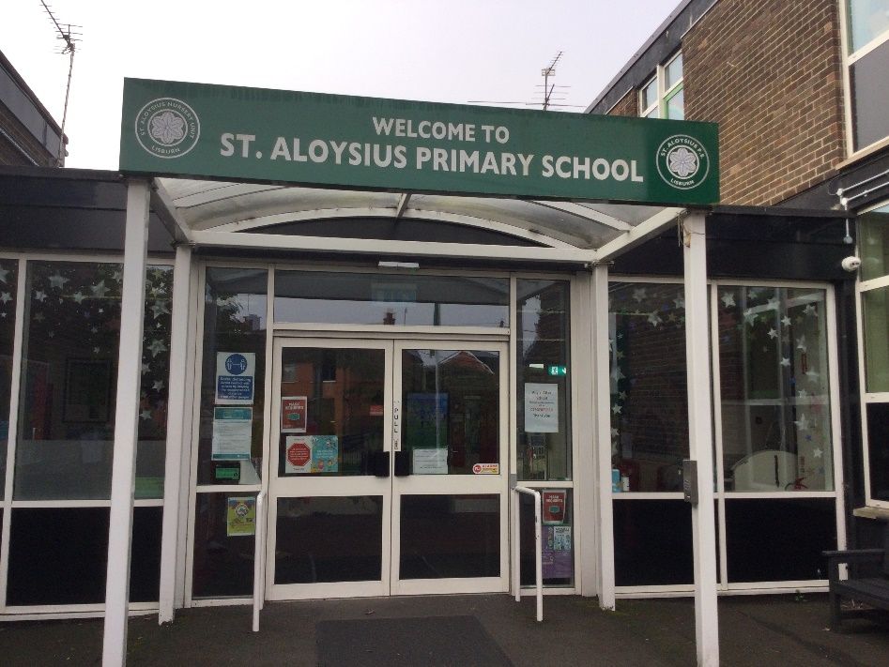
Primary 4 Curriculum Overview 2024-25
“To live, love and learn in a caring Catholic community.”

Slide 2
P4 Curriculum
Numeracy
Literacy
World Around Us
Physical Education
The Arts
PDMU
Grow In Love
ICT

Slide 3




Numeracy Overview
Mental Maths:
Counting on and back
Rounding up and down
Ordering numbers
Number:
Place value to 999
Addition and subtraction within 999
Multiplication and division
Measure:
Length
Weight
Capacity
Time
Shape and Space:
2D & 3D Shapes
Area & perimeter
Symmetry
Problem Solving:
Word problems
Mathematical language
Different strategies
Apply knowledge and understanding
Data Handling:
Collect, interpret and present data
Pictograms, Bar graphs, Venn & Carroll Diagrams

Slide 4




Reading
Talking & Listening
Writing

Slide 5


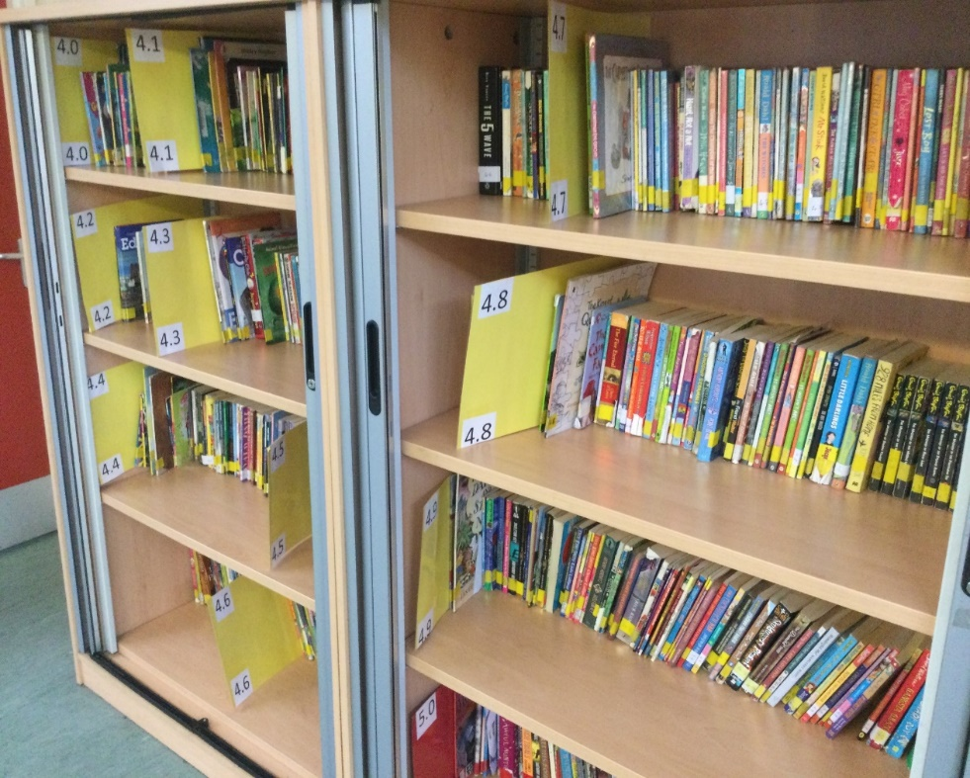
Fluency, Expression and Understanding
https://ukhosted49.renlearn.co.uk/2235199/
http://www.arbookfind.co.uk/

Slide 6
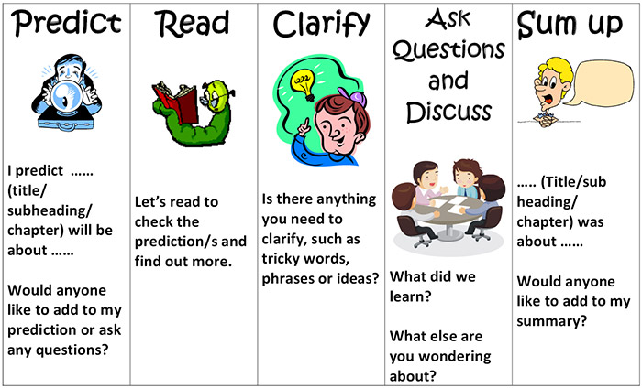
Comprehension

Slide 7


Reading tips to help your child
Activities that your child could complete after reading a book;
Design a book cover
Write a summary of the story
Write a description of their favourite character
Draw and describe the story setting
Create a new character for the story
Write a new ending for the story
Write a book review
Create a character fact file
Research the author/illustrator of the book
Create a word search using vocabulary from the story
Create a story board to recount events
Find a quiet place
Use phonic strategies to identify unfamiliar words
Look at punctuation marks to develop fluency and expression
• Talk to your child about the story e.g.;
Discuss the illustrations
Retell the story
Describe the story setting, events and characters
Ask who was your favourite character? Why?
Which part did you like best?
Can you predict what will happen next?
Look up unfamiliar words using a dictionary/online dictionary

Slide 8

Writing
Presentation
Accurate letter formation
Begin sentences at the margin
Write on the line
Spacing between words
Understand the range of writing forms with guidance.
Recount
Procedural
Narrative
Report
Explanation
Persuasion
Spelling, Grammar and Punctuation
Learn spellings and apply phonic strategies to unfamiliar words.
Parts of Speech
Use accurate punctuation
Express a range of thoughts and feelings and begin to write with greater independence and imagination.

Slide 9




World Around Us

Slide 10



The Arts
P.E, Music & Drama

Slide 11



Grow In Love & PDMU

Slide 12




ICT
Desktop publishing
Research
Digital Storytelling
Green Screen
Word Processing & PowerPoint

Slide 13

Thank you for signing up to Seesaw. This app enables us to establish an effective form of communication between home and school.
Please check this app regularly as messages and updates will be sent regarding your child’s class.
Teachers will respond to Seesaw messages before school starts: 8.30am – 8.45pm & from 3.00pm – 4.00pm.
Please contact the school office (028 9266 2293) with any urgent messages, during the school day.
Seesaw is closed for all communication at the weekend and each evening.
We would actively encourage you to keep us updated on any developments that could affect your child’s education.

Slide 14
Homework
Monday: Literacy- Comprehension
Tuesday: Mental Arithmetic
Wednesday: Grammar
Thursday: Freckle
Friday: Spelling and Mental Maths test
*Learn spellings and read for 20 minutes every night.
*Accelerated Reading quizzes can be completed in school each morning.

Slide 15


Assessment For Learning (AFL)
Pupil involvement.
Assessment for learning based upon Learning Intention and Success Criteria.
Peer/Self-Assessment.
Target setting.
Half-Termly assessments.
Accelerated Reader/Freckle.

Slide 16

Appointments to speak with the class teacher can be made at any stage of the school year. Please phone the school office or message the teacher directly via Seesaw.
Parent Teacher Meetings will be held on Monday 27 January 2025.
We look forward to working in partnership with you this year.
Mrs Russell P4A
Miss Donnelly P4B

