Slide 1

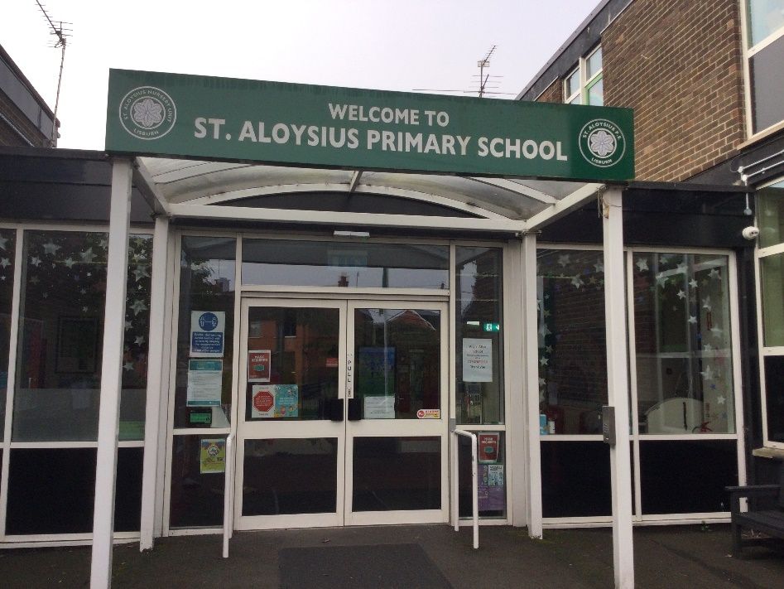
Primary 5 Curriculum Overview 2024-25
“To live, love and learn in a caring Catholic community.”

Slide 2
P5 Curriculum
Numeracy
Literacy
World Around Us
Physical Education
The Arts
PDMU
Grow In Love
ICT

Slide 3

Talking and listening
Reading
Writing
‘Literacy is a journey not a race’

Slide 4

Talking and listening

Slide 5

Reading
Modelled
Shared
Guided
Independent

Slide 6
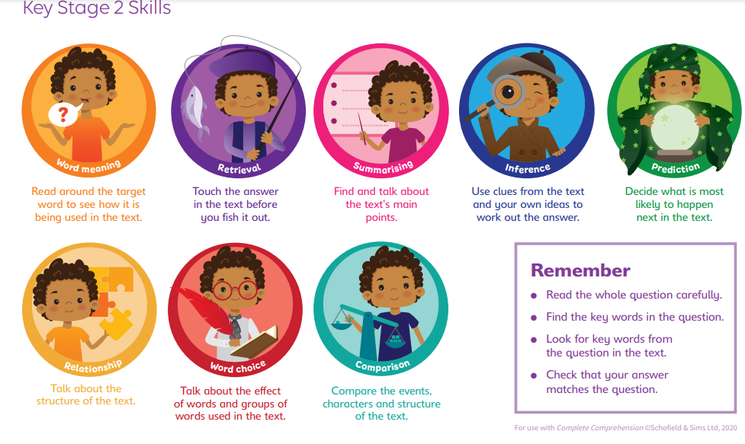
Comprehension

Slide 7

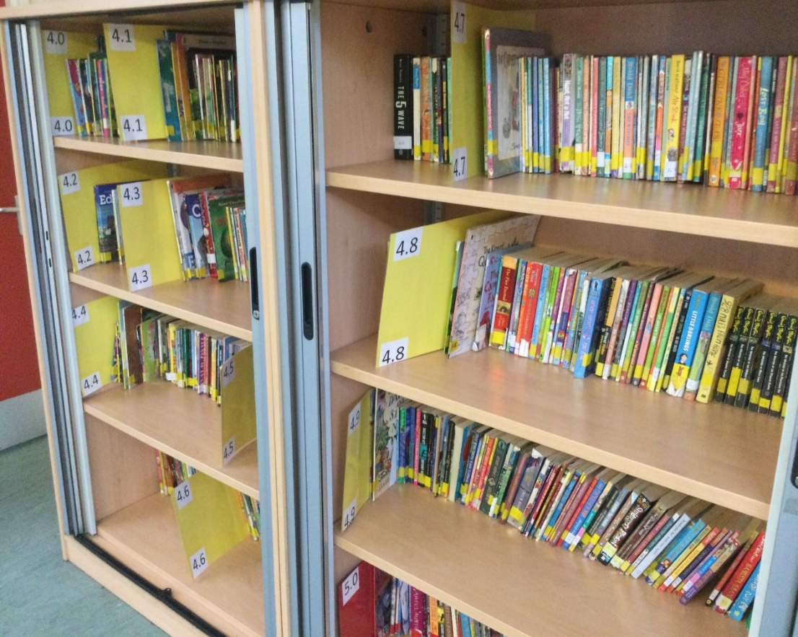
http://ww.arbookfind.co.uk/
https://login.renaissance.com/12d2ca95-9a5b-43d7-acc9-1eea477b4030?state=13d1f014-c523-4fa0-98ed-5f31dc791cb9

Slide 8
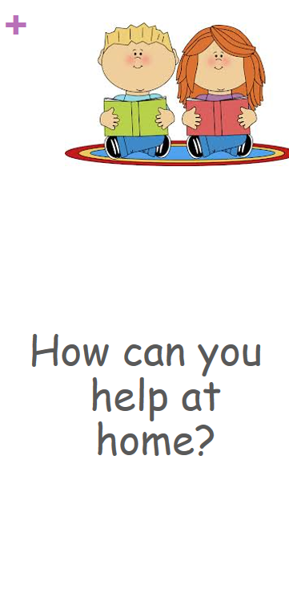
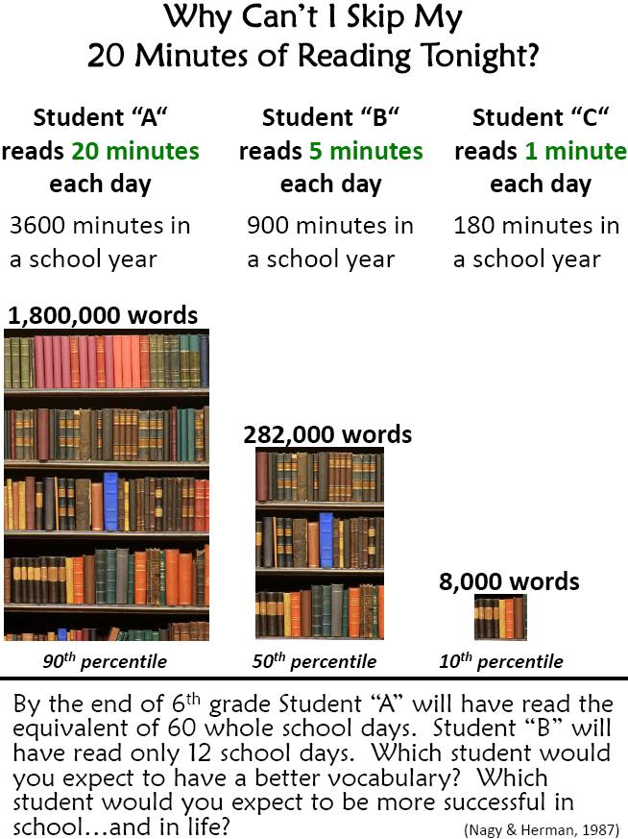

Slide 9

Different styles of writing

Slide 10
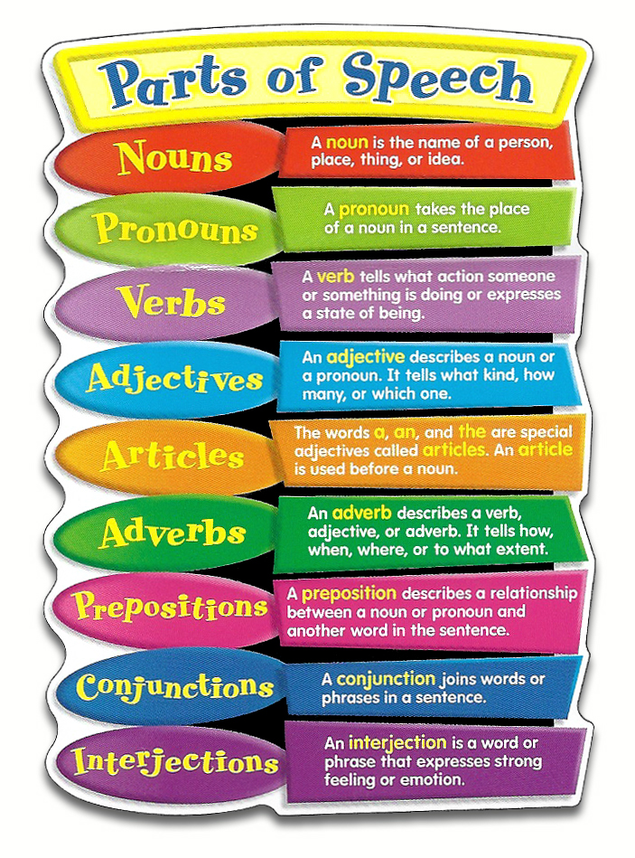
Grammar

Slide 11

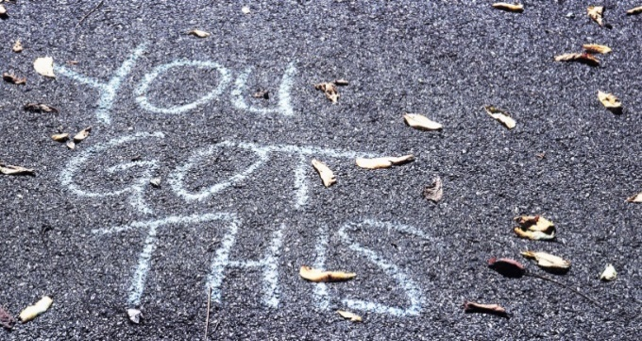
Listen to your child read and discuss the story/characters/plot.
Encourage your child to study their spellings every night using spelling shed.
To foster a love of reading, provide your child with opportunities to read a wide variety of texts.
Keep informed of your child’s progress in‘ Accelerated Reading’ by logging into to their account.
Join the local library.
Praise every step they take in becoming
readers and writers.

Slide 12

Numeracy Overview
Number:
Place Value
4 number operations
Written and Mental strategies
Measure:
Length
Weight
Capacity
Time
Problem Solving:
Word problems
Mathematical language
Different strategies
Apply knowledge and understanding
Shape and Space:
2D & 3D Shapes
Area & perimeter
Symmetry
Angles
Handling Data:
Collect, organise and present data
Venn & Carroll Diagrams

Slide 13
Developing mental maths skills
Rapid recall
Multiplication
Division
Addition
Subtraction
Weekly testing
Partitioning
Doubles & Halves
Rounding
Online Games
Topmarks
Mathletics
Different Strategies

Slide 14
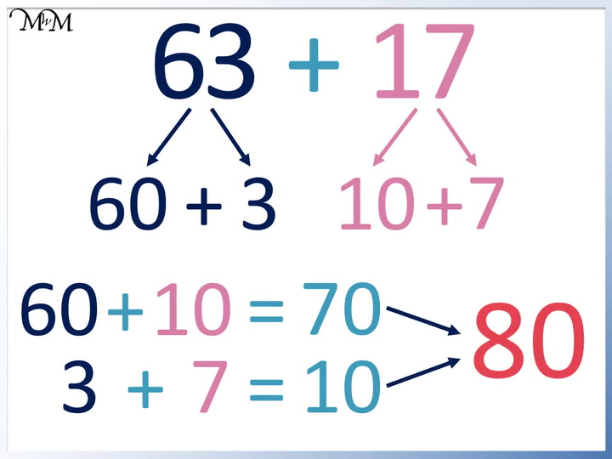
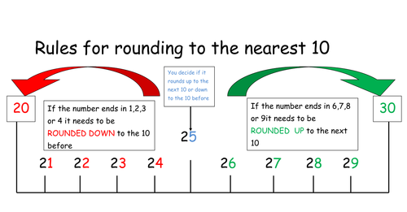
Partitioning
Rounding

Slide 15



How can you help develop maths understanding at home?
Revise daily
Encourage independence
Real world experiences
Support

Slide 16




World Around Us

Slide 17

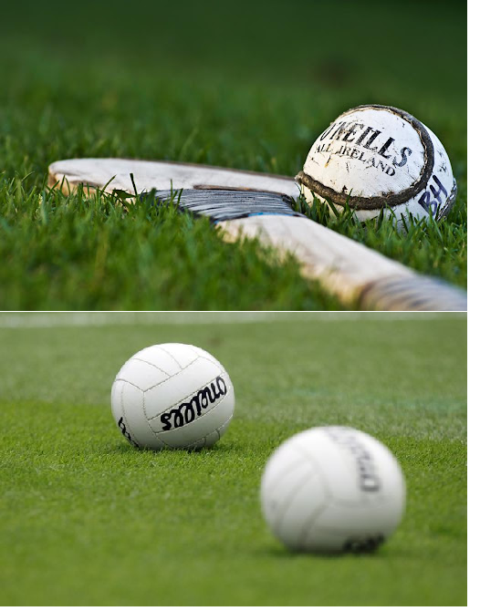

Physical Education

Slide 18

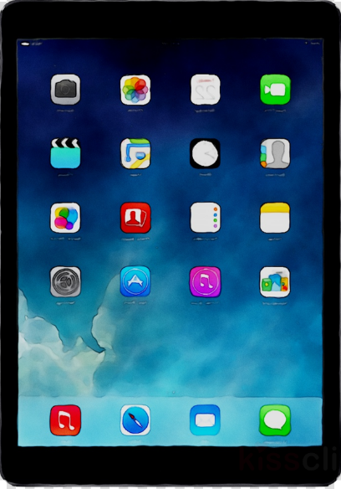


ICT
Desktop publishing
Research
Digital Storytelling
Green Screen
Word Processing & PowerPoint

Slide 19


Grow In Love & PDMU
Christian Faith
Word of God
Christian Morality
Liturgy & prayer
Early Irish Christianity
Uniqueness
Emotional Understanding
Peer relations & Self-esteem
Problem solving

Slide 20



Assessment For Learning (AFL)
Pupil involvement.
Assessment for leaning based upon Learning Intention and Success Criteria.
Peer/Self Assessment.
Target setting.
Half-Termly assessments.
Accelerated Reader/Mathletics.

Slide 21

Thank you for signing up to Seesaw. This app enables us to establish an effective form of communication between home and school.
We would actively encourage you to keep us updated on any developments that could affect your child’s education.

Slide 22
Homework
Homework due to be submitted each day
Monday – mental maths
Tuesday Comprehension/Grammar
Wednesday – Times tables booklet
Thursday – Freckle
Spellings and reading daily
Written homework and spellings should last approx. 30 minutes and we encourage all pupils to read for at least 20 minutes at home each evening.

Slide 23

If you have any questions or queries regarding your child’s year in P5 please do not hesitate to ask.
Mrs Wright, Miss Murphy and Mr Rafferty

