Slide 1

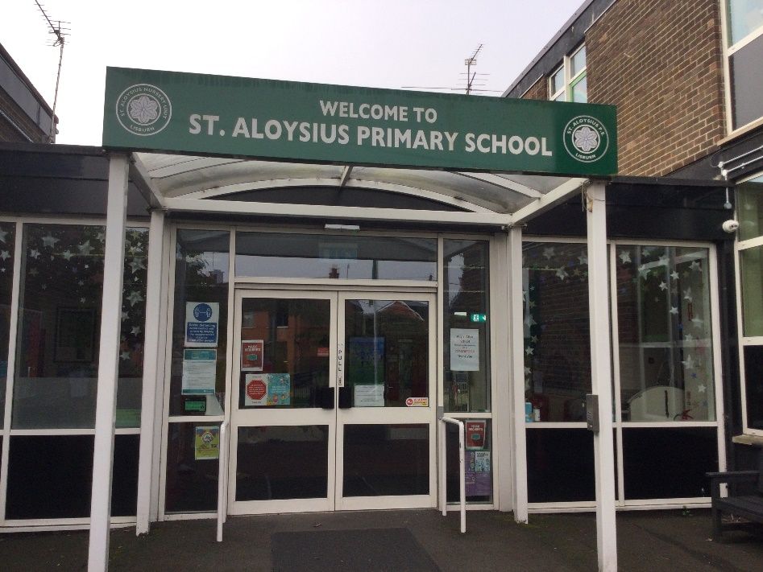
Primary 3 Curriculum
2022/23
“To live, love and learn in a caring Catholic community.”

Slide 2
Overview
Outline of P3 Curriculum
Homework
Developing Independence
Positive Behaviour Approach
General Housekeeping

Slide 3
Curriculum
Outline of Primary Three Curriculum
Literacy
Phonics
Mathematics and Numeracy
World Around Us (History, Geography, Science)
ICT
The Arts (Art, Music, Drama)
Personal Development and Mutual Understanding (PDMU)
Religion
Physical Development and Movement (PE)
Activity based Learning ( ABL )

Slide 4
Literacy
Reading (in school)
Aim to create independent, keen and enthusiastic readers
Guided reading – Reading in small groups
Shared Reading – Encouraging the children to interact with a text and read as part of a whole group

Slide 5
Literacy
Reading (at home)
Always keep reading positive and enjoyable.
Encourage children to use a loud, clear voice.
Encourage independence
Check that children are following across the lines (tracking).
Discuss stories and ask questions.
Remember that the children are using EASY READS at home and these are at a level below the level they are doing in school – This should mean that reading is an enjoyable experience for both you and your child.

Slide 6
Literacy
Writing:
Become independent writers through a variety of writing activities e.g. recalling events and trips, postcards, letters, imaginative writing.
Talking& Listening:
These are essential life skills as they enable your child to express themselves and follow direction in class
.
Handwriting:
Letter formation
Capital/lower case letters
Use accurate punctuation
Finger spacing between words

Slide 7
Phonics
We follow the Lingusitic Phonics programme.
Until Halloween we will be revising the P2 phonics curriculum.
After mid – term children will receive spellings based on the phonics programme .
Children will work on these words all week in class, as well as completing a daily homework on these words – all in preparation for a Friday assessment .

Slide 8
Mathematics and Numeracy
Developing mathematical skills, language and thinking
Reinforced by practical work and mental maths
Problem-solving: challenging children to think for themselves

Slide 9
Mathematics and Numeracy
In Primary 3 Numeracy is taught through:
- Number work
- Topic work
- Mental maths
There is a big emphasis on problem solving which we implement into both number and topic work.

Slide 10

Mental Maths
Quick recall;
-Addition and subtraction facts
-Numberbonds
-Counting in 2s, 3s, 5s and 10s
-Doubles and near doubles
-Rounding up and down
-Inverse operations
-Understand and use mathematical vocabulary and language
School:
-Magic Number
-Daily ten
-Weekly mental test
Useful Websites:
-Topmarks
-BBC Bitesize
-Whiterose Maths

Slide 11
ICT
Constantly developing their ICT skills through CCEA ICT tasks. (5 per year)
Use both the ICT suite and iPads
Logging on/off
Navigating around screen/ various programmes and apps (supporting the curriculum)
Games / Websites (Enrich learning)

Slide 12





World Around Us
Under the Sea
Houses and Homes
Space
Food

Slide 13
The Arts
Music - Singing in class and assemblies – Link to Grow in Love and topics
Drama – Through role playing activities - RE/PDMU/Literacy
Art and design - variety of activities and materials throughout the year, encouraging the children to be creative

Slide 14


Grow In Love & PDMU

Slide 15
Activity Based Learning
This is where we encourage and teach the children to learn through play.
We link this to our World Around Us Topics
Construction
Roleplay
ICT
Design & Technology
Play dough
Art

Slide 16
P.E
Indoor and outdoor activities
Children will be encouraged to develop knowledge, understanding and skills across the PE curriculum.
PE day – Wednesday
School tracksuit and trainers ONLY
P.E kit can be used for afterschool sports activities

Slide 17
Homework
Will reflect learning in school
Will be given weekly to be returned on Friday.
This will include a:
Literacy, Numeracy, Phonics/ spellings and Religion task
Reading books and reading records also to be returned on a Friday
Please sign
Spellings will begin after Halloween
*Revision of spellings each night for our Friday spelling test.

Slide 18
Break and Lunch
Break
To consist healthy snacks and water or milk to drink.
NO NUTS!!
Lunches
- If your child goes to school dinners – please book them in, in advance – even if they are free on Eduspot

Slide 19
Developing Independence
Primary 3 children need to be independent in their learning, work and behaviour.
They are responsible for their own belongings – Please label all belongings.
Linked with active listening.
Impacts upon teaching and learning (being able to do things for themselves / remaining on task)
Be prepared to ‘have a go’
Encourage independence at home

Slide 20
Positive Behaviour
Positive approach to behaviour management.
School / Class rules/ Playground rules are all in place.
Rewards – Table points/ personal star or sticker charts and KS1 Star of the week
Consequences - timeout/ cool down where necessary

Slide 21
Thanks for all your support so far!
Learning is a partnership between home and school. We have your child’s best interests at heart so please do not hesitate to contact your child’s teacher if you feel the need. Our door is always open.
Reminder for all parents to sign up to Seesaw as this is how we communicate with our parents
Remember to check the school website for the weekly newsletter
Thank you

